Slide 1


Transaction data insights
For Data from 2009 to 2011

Slide 2
Contents of this Presentation
Exploratory Data Analyses :
Understanding the Key Dimensions
Transaction History Deep Dive
Customer behaviour Dimension
Customer Reorder / Return / Loyalty
Geographical Dimension
Temporal Dimension
Product Dimension Deep Dive
Price
Revenue
Appendix 1 : Data Integrity
Incoming Data , Cleaning , Checking , Assumptions
Appendix 2 : Future Improvements
Appendix 3 : Code-Base Brief Overview

Slide 3
Understanding the Data Set
What are the Key Dimensions and Facts

Slide 4
The Data Set contains Transaction / Ledger details for a retail company
~1M records from Jan-2009 to Dec-2011
In essence the Data is at an Invoice-Item Level
The following Datapoints are available :
Invoice : ID , Date , Order Status
Product : ID , Quantity , Price , Description
Customer : ID , Country
There are significant Data Integrity issues , which have been detailed in Appendix 1 : Data Integrity

Slide 5
Transactions over Months
From Jan-2009 to Dec-2011

Slide 6

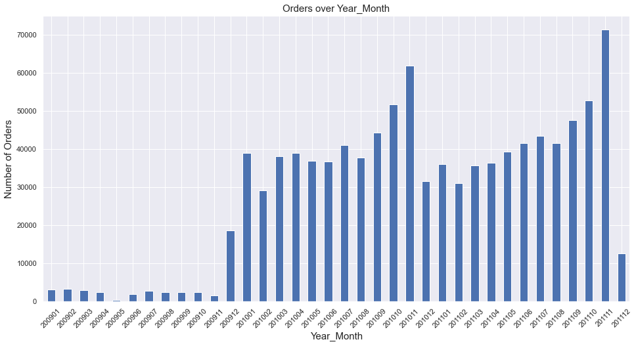



Transactions in 2009 have been very minimal . These Transactions are not uniformly distributed over all weeks These intermittent Transactions could be because of incomplete data or intermittent business operations Sales Pickup Near 2009 EOY , before the Christmas/NY period . A similar seasonal uplift in sales is again observed in 2010 and 2011 in the same Oct/Nov Time period . A consistent seasonal dip in Sales is observed in Dec after the yearly High , this Dip then recovers over the rest of the Year

Slide 7
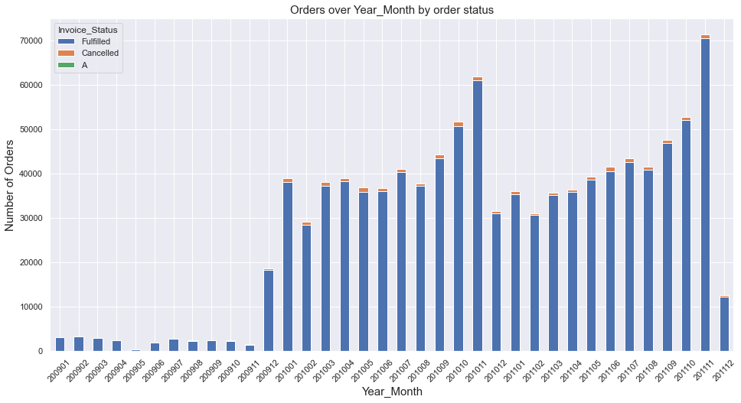
Order Cancellations are usually a minority at < 2% , Cancelled Orders also coincide a lot with the datapoints that have poor quality , this is detailed in the Appendix 1

Slide 8
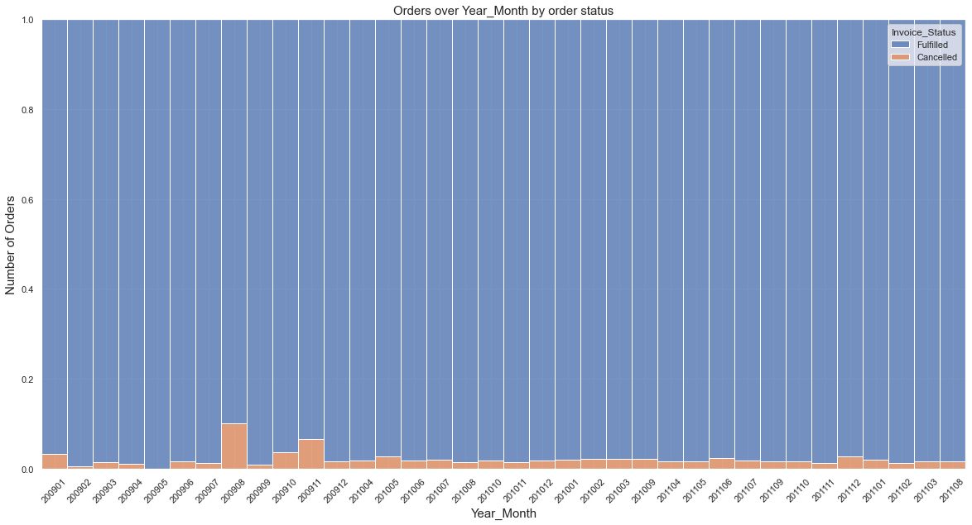
Order Cancellations ( Orange ) normalized share : The last time Cancelled Orders peaked was in 2009 Aug and Nov , the data is sparse there and it is difficult to conclude the reason for this life in Cancellation , without a deeper look and situational information

Slide 9
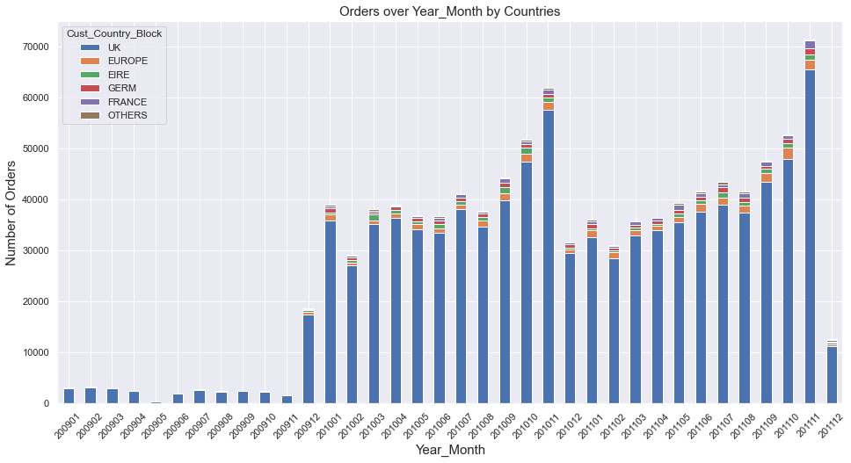
Majority of the Transactions ( 92 % ) and Sales Volume ( 85% , $16M ) is attributed to UK , UK is probably the Domestic Market for this company .

Slide 10
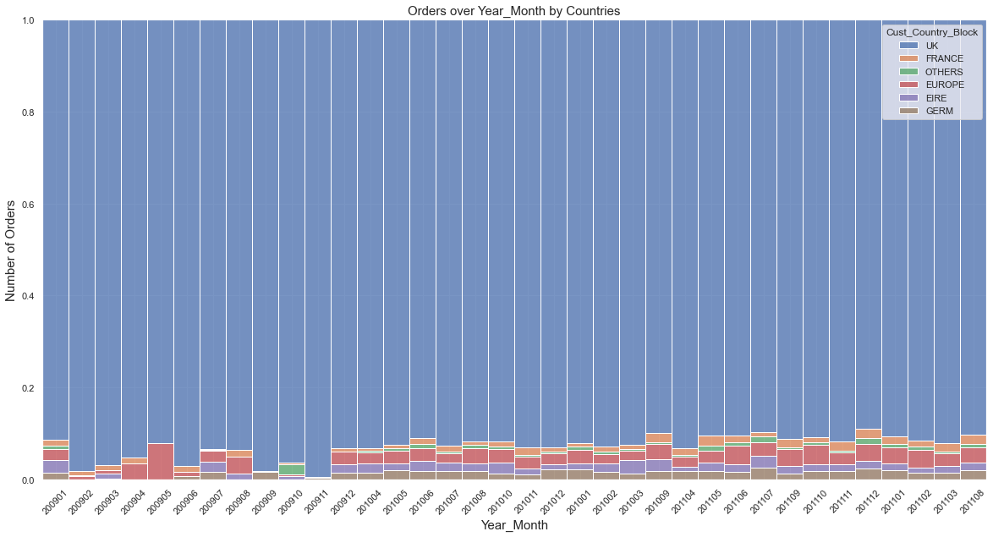
Domestic vs International Share has not changed much since 2009 , With France and the Rest of Europe having similar Trn. Volumes

Slide 11
Investigating Customer Loyalty Order –> ReOrder OR DropOut
re-ordering can be observed at 2 levels
one is a Customer Level - where a customer revisits the business,
regardless of whether he buys the same items or not
the other scenario to study is when customers return to buy the same item multiple times

Slide 12
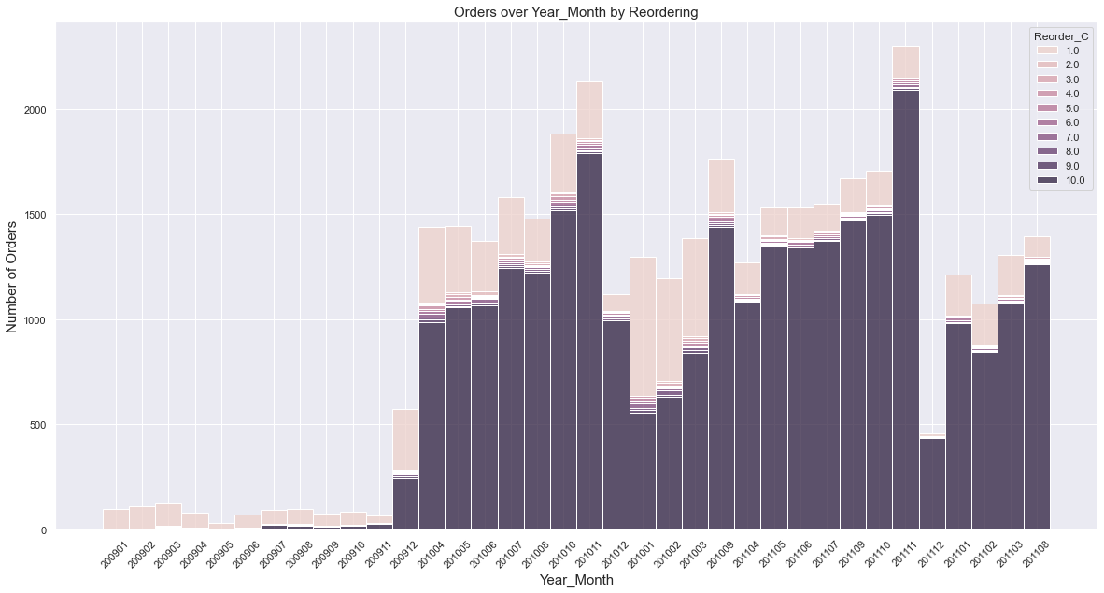
Case 1 : Customer Returns to buy different or even same Items Peach : New Customers ; Dark Purple : Customers who have placed >= 10 orders with company previously Majority of the Customers are Repeat Buyers , Which indicates that the company might be a B2B Supplier who has a small but loyal , recurring customer base

Slide 13
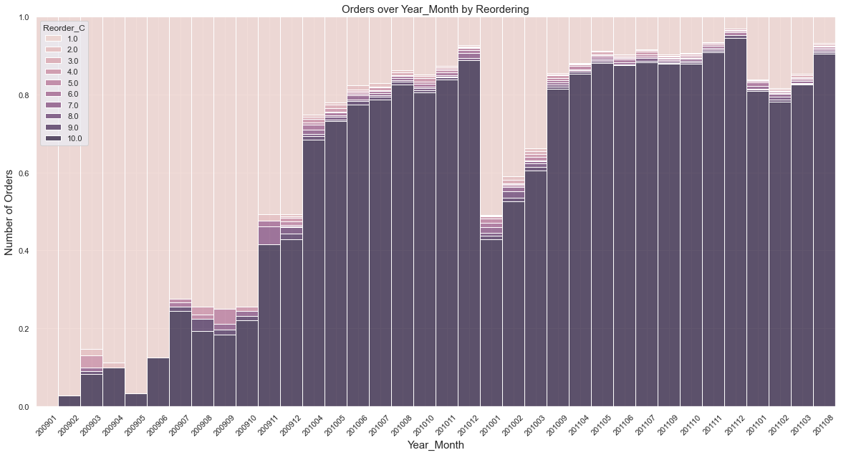
Case 1 : Normalized view : Share of Returning Customers Except New-Years and Christmas , the Customer Loyalty remains high , Dip near NY , might be due to influx of new customers gained from competitors , and some customers lost to competitors

Slide 14
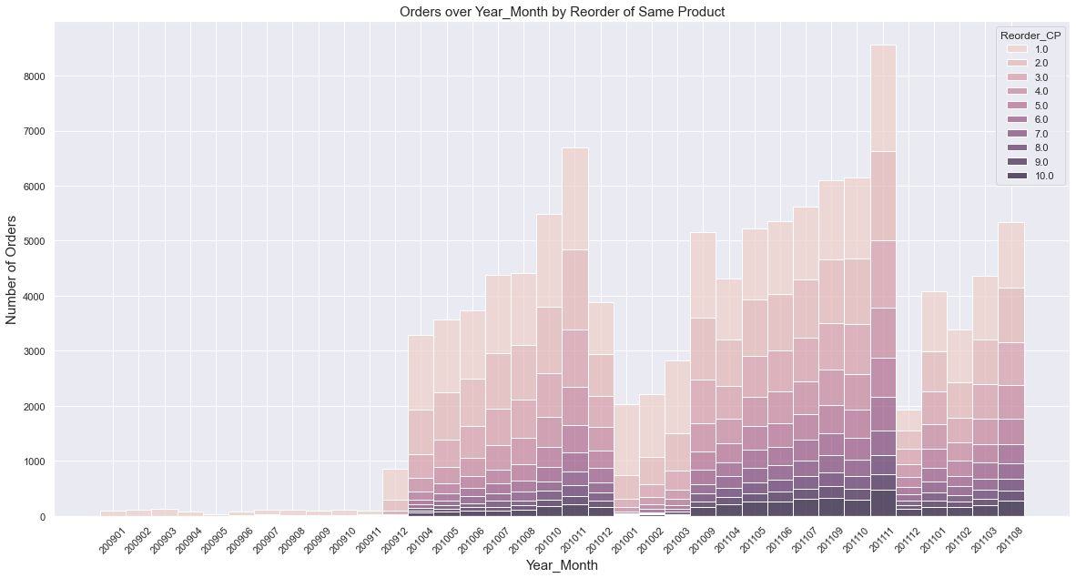
Case 2 : Customer Returns to buy the same Item again Peach : New Customers ; Dark Purple : Customers who have placed >= 10 orders with company previously Majority of the Customers are Repeat Buyers for the same Item , Which indicates that the company might be a selling an AYR/365 Item

Slide 15
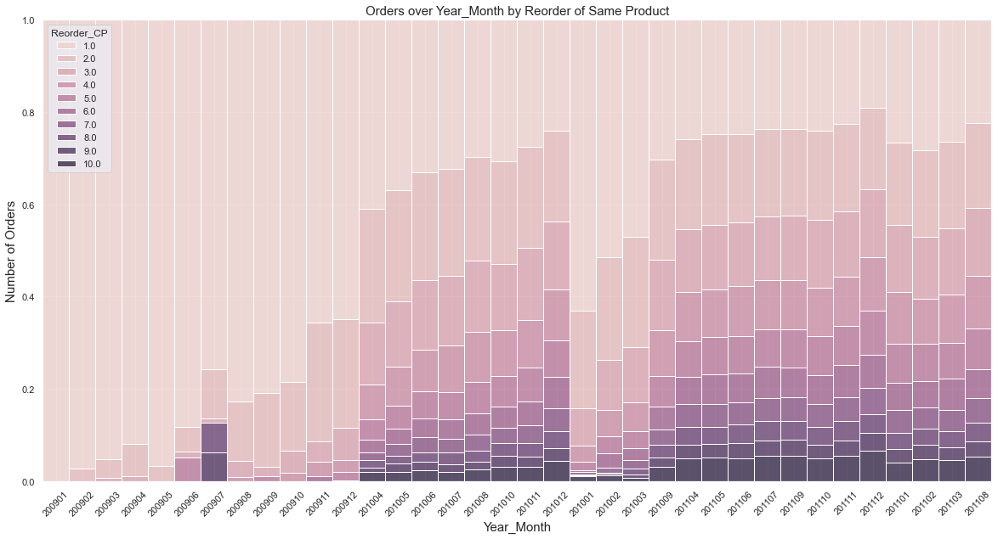
Case 2 : Customer Returns to buy the same Item again Except New-Years and Christmas , the Customer Loyalty remains high , Customer share of New vs. repeating Stabilize over time , indicating lesser customer churn

Slide 16
Product and Price Dimension

Slide 17
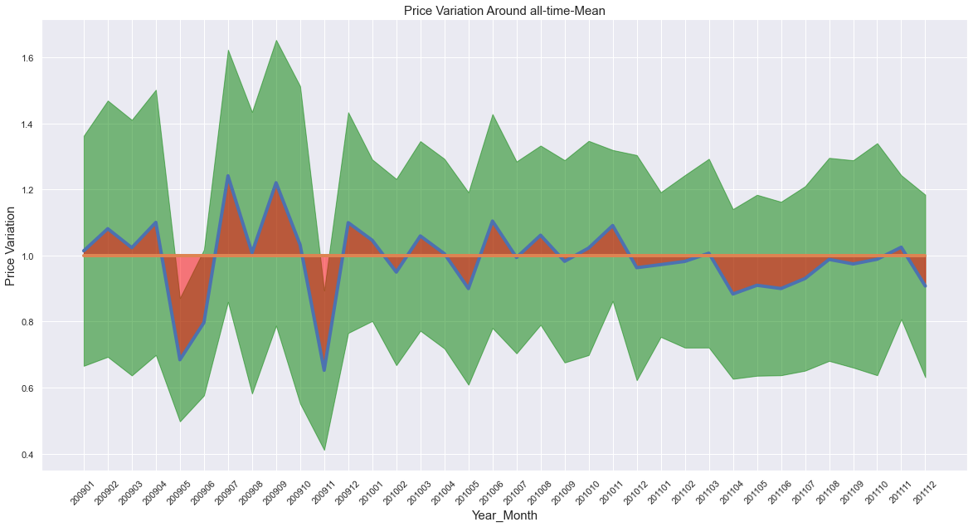
Mean-Normalized Price variation over Time : The Product Price has a trend to decrease over time , indicating Discounts . MarkDowns , Clearances The Product Price was very Volatile in 2009 , this could be because of Unreliable Data and Intermittent Transactions Red : Difference from Historical Mean Price at Product level , Green : Standard Deviation

Slide 18
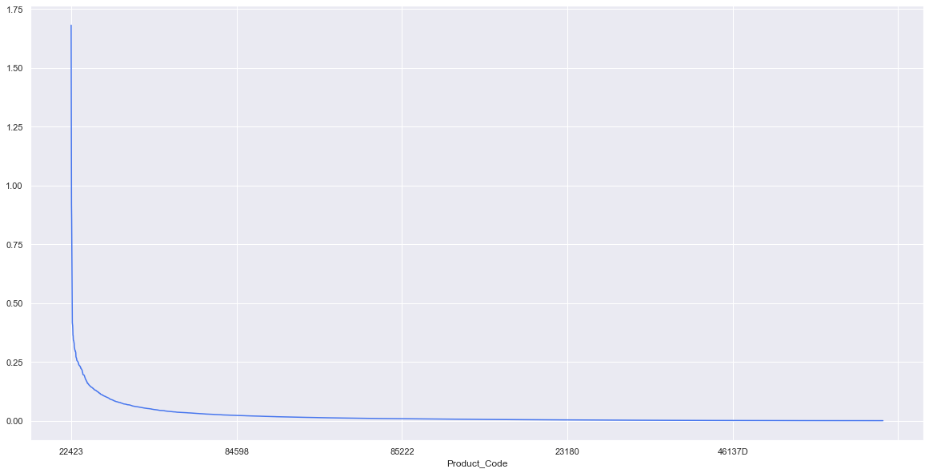
the top selling product only accounts for 1.6 % of the sales , which implies that the sales are distributed over a wide product line but even then , the sales pattern stills follows a sharp Pareto distribution , with a minority of SKUs responsible for majority of the sales
Product Code | Sales Share %
22423 | 1.68
85123A | 1.31
85099B | 0.92
23843 | 0.86
47566 | 0.75
84879 | 0.66
22086 | 0.60
23166 | 0.42
79321 | 0.41
22197 | 0.40

Slide 19
Transactions Volumes in Day and Week Levels

Slide 20
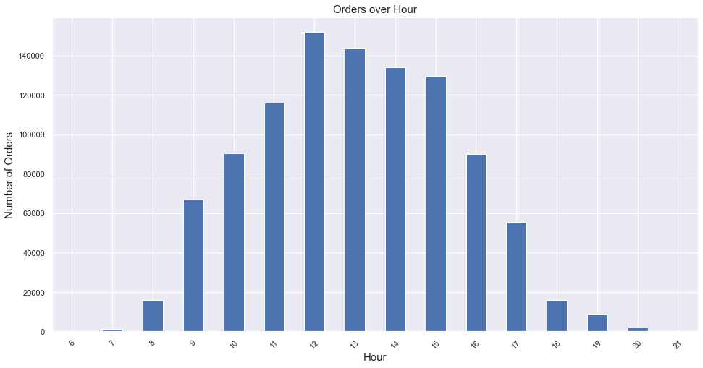
Orders Peak in the Working Hours , which might suggest that the company is an Industrial / B2B supplier , instead of a consumer retailer

Slide 21
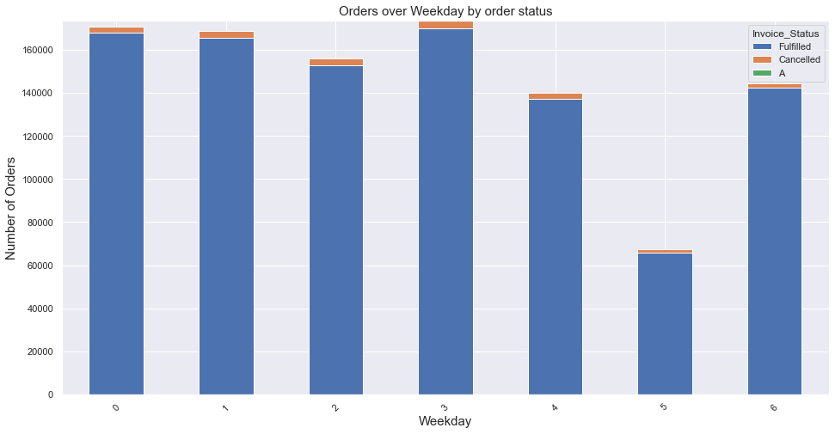
There are very Few Orders coming in on Saturdays , while Sunday Seems to be an active Day It is possible that the company could have an Online Channel too for accepting Orders on Non-Working days

Slide 22
Appendix 1
Data INTEGRITY DEEP-DIVE

Slide 23
Steps In the Data Pipeline
Export Data from Incoming Excel to Create CSV dumps
Append 2 CSVs to create a Pandas DF
Remove Absolute Duplicates ( entire row is same ).
Establish Logical Level of the Data
Data is supposed to be at Invoice-Item Level
Rename Columns for Readability and Ease-of-use
Remove Cancellation encoding from Invoice_ID as a separate flag column
Analyse Product Code for Anomalies , and create a Flag to mark these
( DeepDive in next slides )
Type setting of Columns

Slide 24
Anomalous Data Points in Columns
Analyse Negative Values in Product_Qty
86% of Negatives explained by Order Cancellations (maybe to adjust inventory count )
Remaining Explained By iNstances where Cust_ID was NULL
Took these Product_Desc as added them to the Adjustment Codes List for the Mask Flag
Analyse Negative Values in Product_Price
Negative Prices are found only During yearly Stock Adjustments , They Have Product Code ‘B’
Special Product_Desc codes explain such discrepancies , added them to the Codes List
Handling Null values in Cust_ID :
Since each Invoice_ID is uniquely mapped to only one Cust_ID
Used Invoive_ID – Cust_ID map to fill in missing Cust_IDs
But this was unsuccessful in filling in , as these missing Cust_IDs were in a block of time

Slide 25
Fixing the Data-Level
Analysing Errors in Logical Data Level
Data is supposed to be at Invoice-Item Level
But on doing Groupby-Count there are 2.2% Instances which violates this level ( i.e. have count > 1)
This was NOT because of there being Duplicate entries for Cancelled Orders
( i.e. one entry for Original order , then one entry when order was Cancelled , This was NOT the case)
There were Multiple Rows with Different Prices and Qtys for the same Invoice-Item Level
Possibly to calculate the same Order-Item at different prices for multiple Qtys
There were very few instances of Product_Desc column showing level discrepancies,
Since that column was not relevant to any analyses , we can ignore those
Fixing the Level to Inovice-Item :
All the columns were Aggregated appropriately ( Sale : Sum , Qty : Sum , Price : Mean , Rest : Mode )

Slide 26
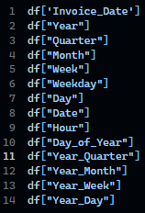
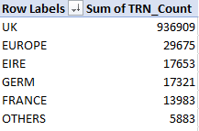
Creation of Auxiliary Features for Analysis
Time Dimension Features for Group Bys :
created from TimeStamp column : Invoice_Date
Levels : Year , Quarter , Month , Week , WeekDay , Day , Hour
Country column simplification
There were 43 distinct countries ,
But ‘UK’ Accounts for 93% of Transactions
So grouped Countries into based on Sales and Geography
Exported Final data for Consumption in Analysis

Slide 27
Appendix 2
Further Improvements AND NEXT STEPS

Slide 28
More things to try out
Rate of Sale Analysis :
Which item sells fast , which Items sell slow ,
80-20 profitability/importance analysis
Order Cancellation RCA
What circumstances lead to cancelled orders
RFM Analysis : Recency , Frequency , Money , can be split by age also
Augment with Product Dimension Data
Top contributors to Sales : By Product , Department , RBU , Product-Age , HomeBrand etc
Augment with Customer Dimension Data like Age , Gender , First-Purchase-Date
“are our older customers our high value customers” , “do the younger people shop more frequently”
Customer Segmentation ( Unsupervised Clustering )
Using Item-description for NLP embeddings , WordClouds
Clustering , by Weightage to Monthly Revenue to

Slide 29
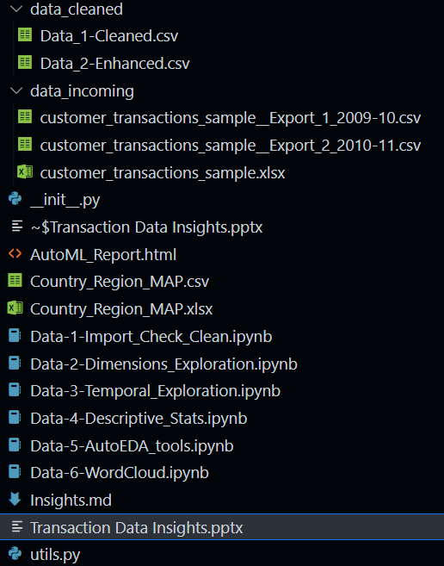
Appendix 3
Brief Code Base Over-View

Slide 30
Thank You
Saif. Raja
7775029864
saifuddin.raja24@gmail.com

